Slide 1
The village
By: Stephen Pura
Noah Watkins
Gerardo Vargas

Slide 2
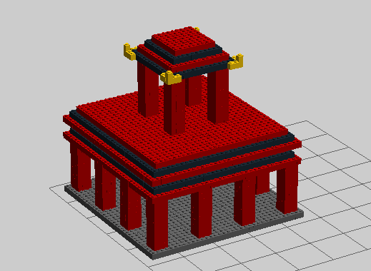
SHRINE

Slide 3
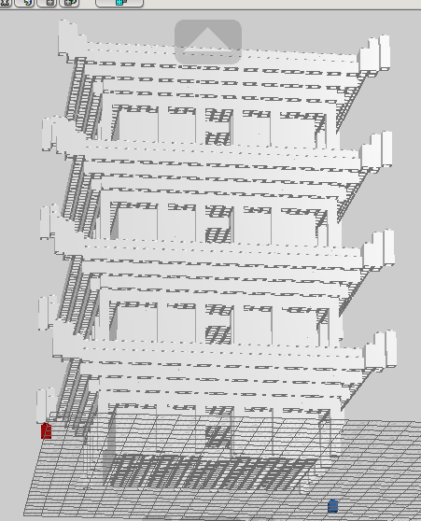
Pagoda

Slide 4
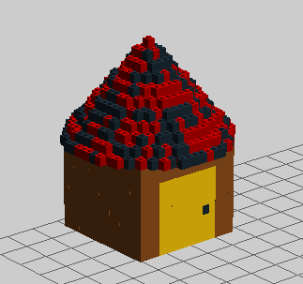
Hut

